Slide 1
Flexible pendulum
ENAE 646 – Advanced Dynamics Course Project Date: 5/9/2019
Name: Prateek Jaya Prakash

Slide 2
Presentation overview
Motivation.
Project background.
Discrete elastic rod theory.
Formulation of equations.
Pendulum under pure stretching.
Pendulum under bending and stretching.
Future work/ Challenges

Slide 3
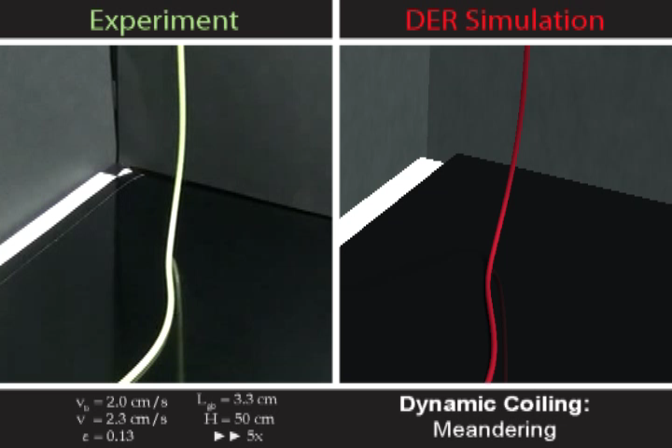
Motivation
Research in the area of soft robotics has created a need for flexible materials.
Modelling flexible systems is challenging because the dynamics are non-linear and usually occur as partial differential equations.
Extensively used in field of computer graphics.
http://www.cs.columbia.edu/cg/elastic_coiling/

Slide 4
References
[1] M. K. Jawed, A. Novelia, and O. M. O’Reilly, A Primer on the Kinematics of Discrete Elastic Rods. Springer, 2018.
[2] X. Huang, C. Majidi, A. Novelia, O. M. O’Reilly, D. A. Paley, and W. L. Scott, “On planar discrete elastic rod models for the locomotion of soft robots,” submitted to Soft Robotics.
[3] Travis Brunch, W.L. Scott and D.A. Paley “Hybrid Feedback Control of an Inverted Flexible Pendulum”
[4] M. V. Trivedi, R. N. Banavar, and B. M. Maschke, “Modeling of hybrid lumped-distributed parameter mechanical systems with multiple equilibria,” in Proc. 18th IFAC World Congress, Milano, Italy, vol. 18, no. 1, 2011, pp. 7696–7701.

Slide 5
Project description
The Discrete Elastic Rod theory is one of the many approaches to model flexible bodies.
Based on Kirchhoff's rod theory.
Uses concepts from discrete differential geometry.
Primary focus is on the planar case.

Slide 6
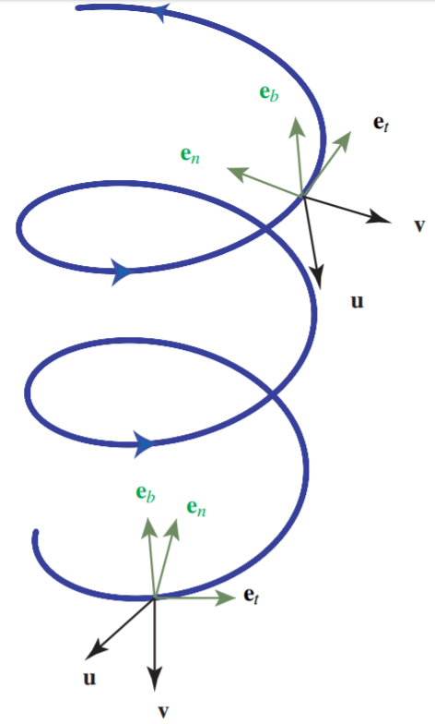
Twist and the center line

Slide 7
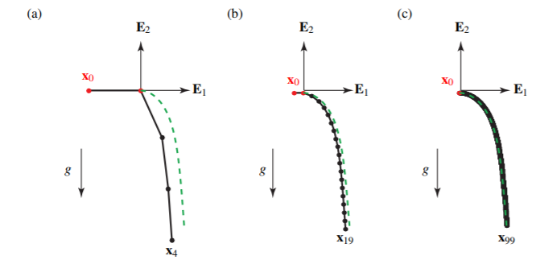
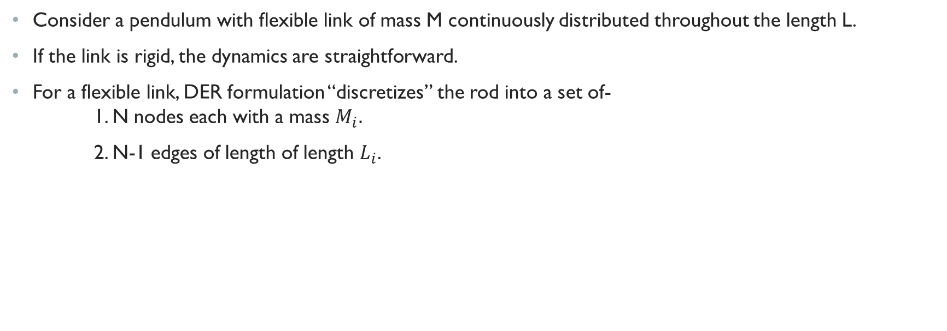
DER formulation
Consider a pendulum with flexible link of mass M continuously distributed throughout the length L.
If the link is rigid, the dynamics are straightforward.
For a flexible link, DER formulation “discretizes” the rod into a set of- 1. N nodes each with a mass $M_{i}.$
2. N-1 edges of length of length $L_{i}$.
Figure 1.1, Jawed, M.K., Novelia, A., O’Reilly O, M.: A Primer on the Kinematics of Discrete Elastic Rods. [1]

Slide 8
DER Formulation (Contd.)
Predicted model is close to the theoretical model (Based on Euler’s classical theory of elasticity) for higher values of N.
Mass is concentrated at nodes, with the links being massless.
A given node ‘i’ is only affected by its immediate neighbors. (Nodes i-1 and i+1).

Slide 9
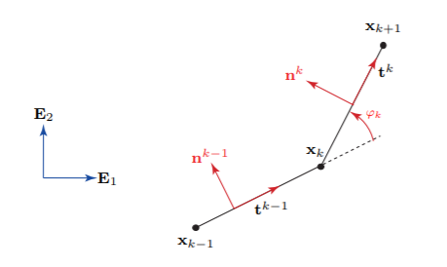
Planar Discrete elastic Rod theory
Twisting about the center line is neglected.
A set of links can stretch and/or bend in a plane. (assume this to be the x-y plane)
$$e^{k} is the edge vector | vector from node k−1 to node k. \\ t^{k} is the unit vector | t^{k}= \frac{\overline{e^{k}}}{\left\|\overline{e^{k}}\right\|}$$

Slide 10
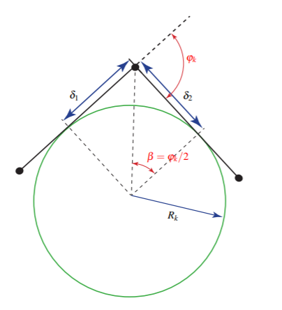
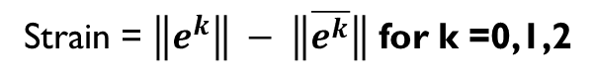
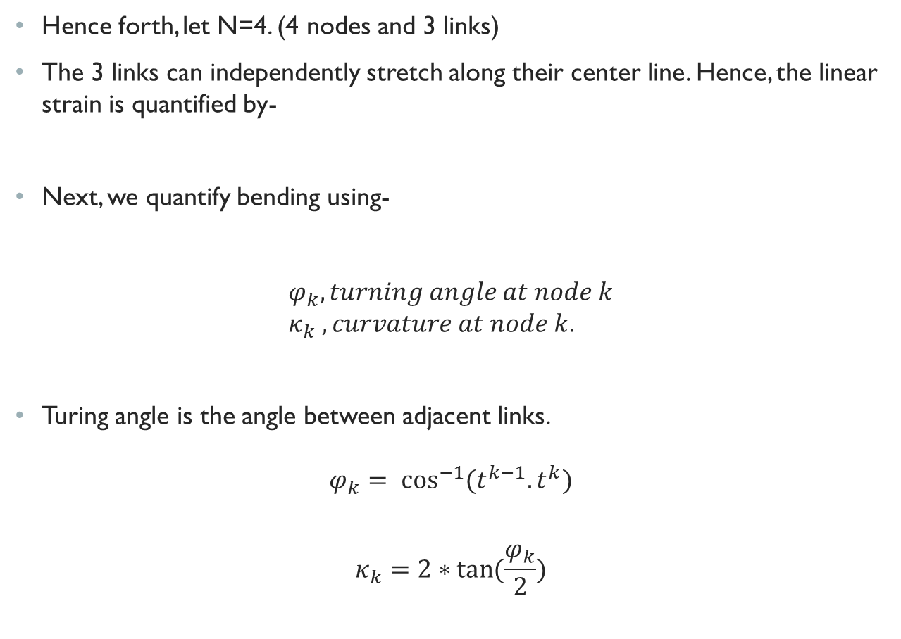
Hence forth, let N=4. (4 nodes and 3 links)
The 3 links can independently stretch along their center line. Hence, the linear strain is quantified by-
Next, we quantify bending using-
$$φ_{k}, turning angle at node k \\ κ_{k} , curvature at node k.$$
Turing angle is the angle between adjacent links.
$$φ_{k}= \cos^{−1}{(t^{k−1}.t^{k})}$$ $$κ_{k}=2∗\tan{(\frac{φ_{k}}{2})}$$
Strain = $\left\|e^{k}\right\| − \left\|\overline{e^{k}}\right\|$ for k =0,1,2

Slide 11
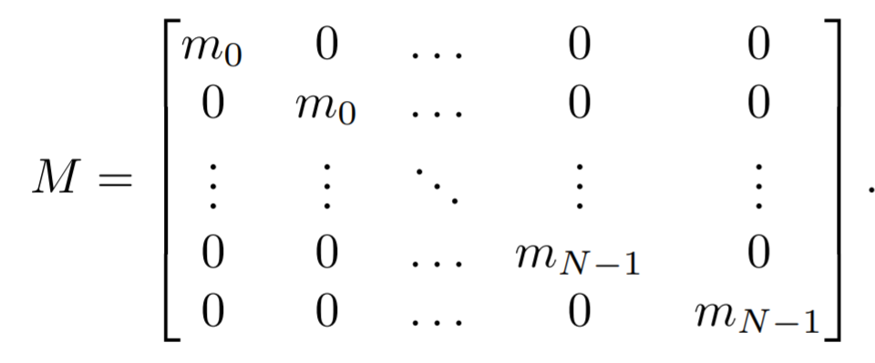
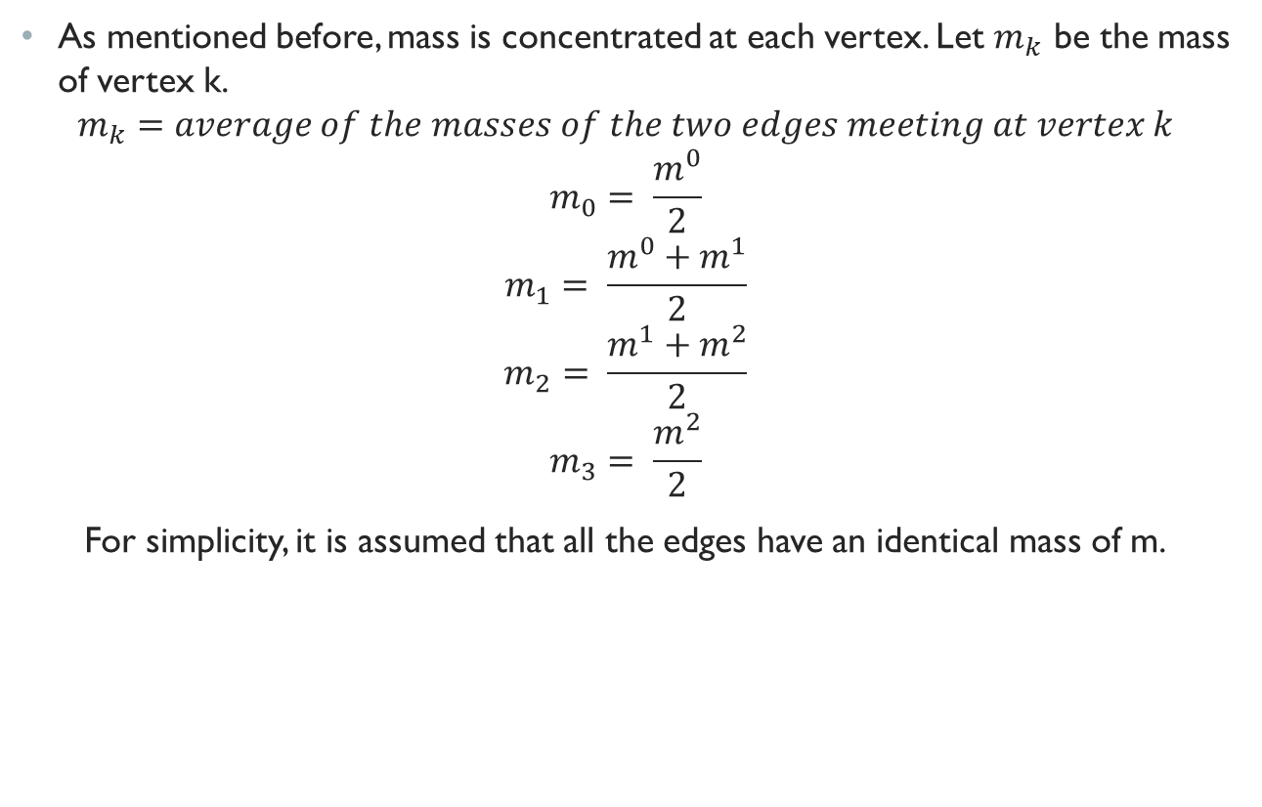
As mentioned before, mass is concentrated at each vertex. Let $m_{k}$ be the mass of vertex k.
$$m_{k}=average of the masses of the two edges meeting at vertex k \\ m_{0}= \frac{m^{0}}{2} \\ m_{1}= \frac{m^{0}+m^{1}}{2} \\ m_{2}= \frac{m^{1}+m^{2}}{2} \\ m_{3}= \frac{m^{2}}{2}$$
For simplicity, it is assumed that all the edges have an identical mass of m.

Slide 12
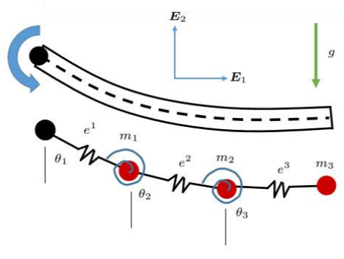
Potential energy of the system
The Discrete elastic model is further simplified by constructing the 4-node model with-
Linear springs representing the edges.
Non-linear torsional springs at the nodes.

Slide 13
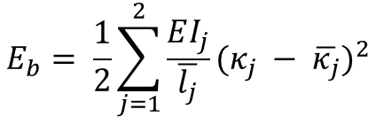
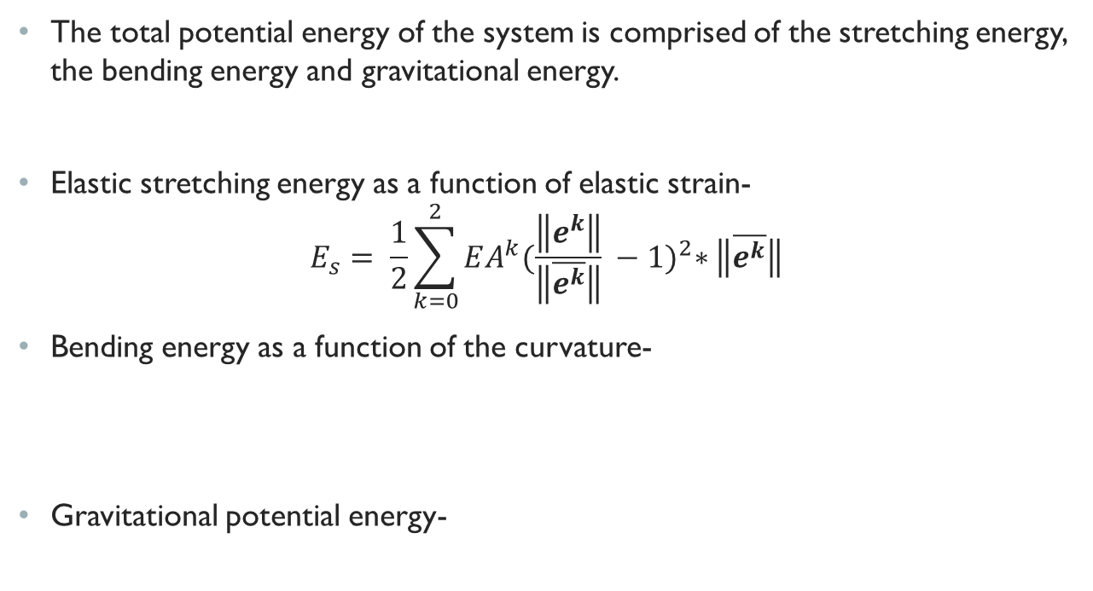
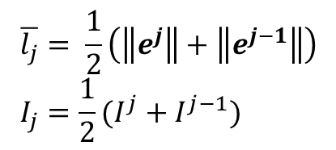
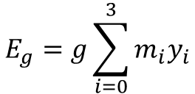
Bending and stretching potential energy
The total potential energy of the system is comprised of the stretching energy, the bending energy and gravitational energy.
Elastic stretching energy as a function of elastic strain-
$$E_{s}= \frac{1}{2}\sum_{k=0}^{2}{EA^{k}{(\frac{\left\|e^{k}\right\|}{\left\|\overline{e^{k}}\right\|} −1)}^{2}∗\left\|\overline{e^{k}}\right\|}$$
Bending energy as a function of the curvature-
Gravitational potential energy-
$$\overline{l_{j}}= \frac{1}{2}\left(\left\|e^{j}\right\|+\left\|e^{j−1}\right\|\right) \\ I_{j}=\frac{1}{2}(I^{j}+I^{j−1})$$
$$E_{b}= \frac{1}{2}\sum_{j=1}^{2}{\frac{EI_{j}}{\overline{l_{j}}}{(κ_{j} − \overline{κ_{j}})}^{2}}$$
$$E_{g}=g\sum_{i=0}^{3}{m_{i}y_{i}}$$

Slide 14
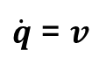
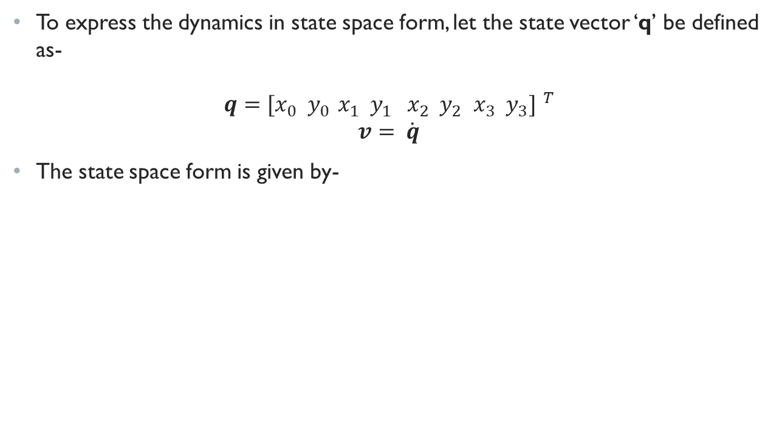
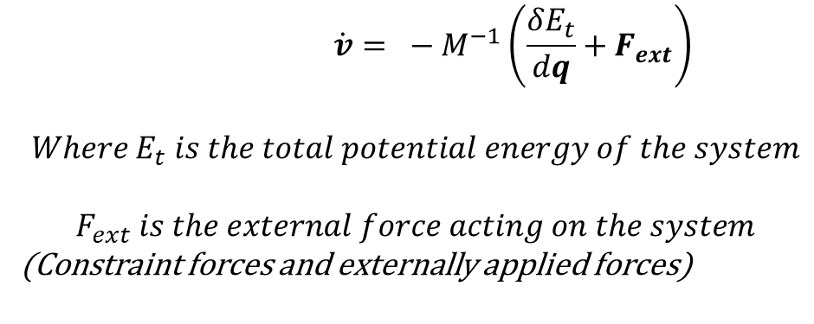
State space model
To express the dynamics in state space form, let the state vector ‘q’ be defined as-
$$q={[x_{0} { y}_{0 }x_{1} { y}_{1 }x_{2} { y}_{2 }x_{3} { y}_{3}] }^{T} \\ v= \dot{q}$$
The state space form is given by-
$\dot{q}$ = $v$
$$\dot{v}= − M^{−1}\left(\frac{δE_{t}}{dq}+F_{ext}\right)$$ $$Where E_{t} is the total potential energy of the system$$ $$F_{ext} is the external force acting on the system$$ (Constraint forces and externally applied forces)

Slide 15
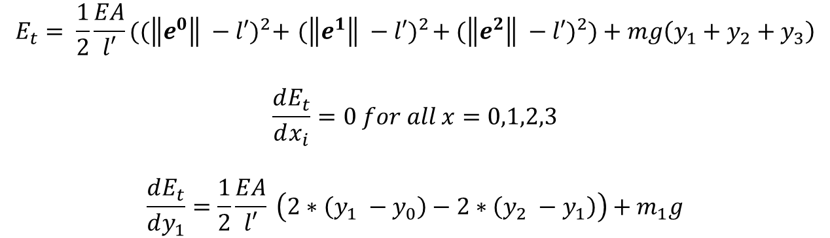
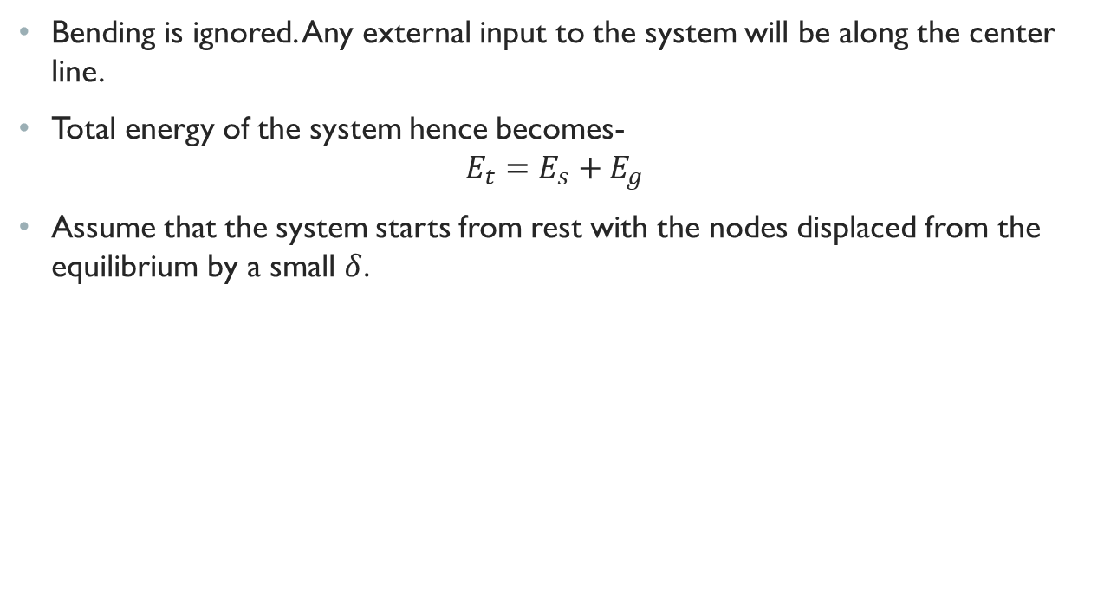
CASE 1: Pure stretching
Bending is ignored. Any external input to the system will be along the center line.
Total energy of the system hence becomes- $E_{t}=E_{s}+E_{g}$
Assume that the system starts from rest with the nodes displaced from the equilibrium by a small $δ$.
$$E_{t}= \frac{1}{2}\frac{EA}{l′}{((\left\|e^{0}\right\| −l′)}^{2}+{ (\left\|e^{1}\right\| −l′)}^{2}+{(\left\|e^{2}\right\| −l′)}^{2})+mg\left(y_{1}+y_{2}+y_{3}\right)$$
$$\frac{dE_{t}}{dx_{i}}=0 for all x=0,1,2,3$$ $$\frac{dE_{t}}{dy_{1}}=\frac{1}{2}\frac{EA}{l′} \left(2∗\left(y_{1} −y_{0}\right)−2∗\left(y_{2} −y_{1}\right)\right)+m_{1}g$$

Slide 16
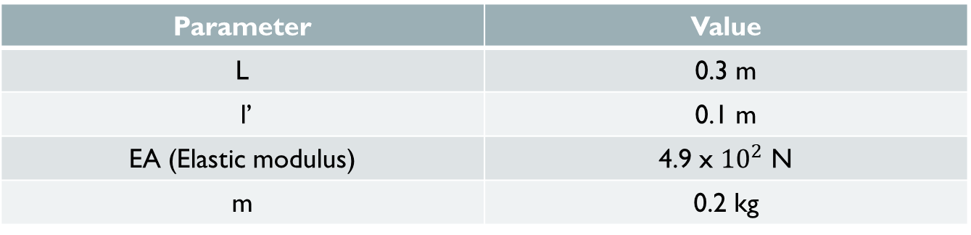
Simulation in MATLAB
Let the system have no external applied forces. The only force acting on the system is the constraint force at node 0. (Because node 0 is assumed to be fixed).
Parameter | Value
L | 0.3 m
l’ | 0.1 m
EA (Elastic modulus) | 4.9 x ${10}^{2}$ N
m | 0.2 kg

Slide 17
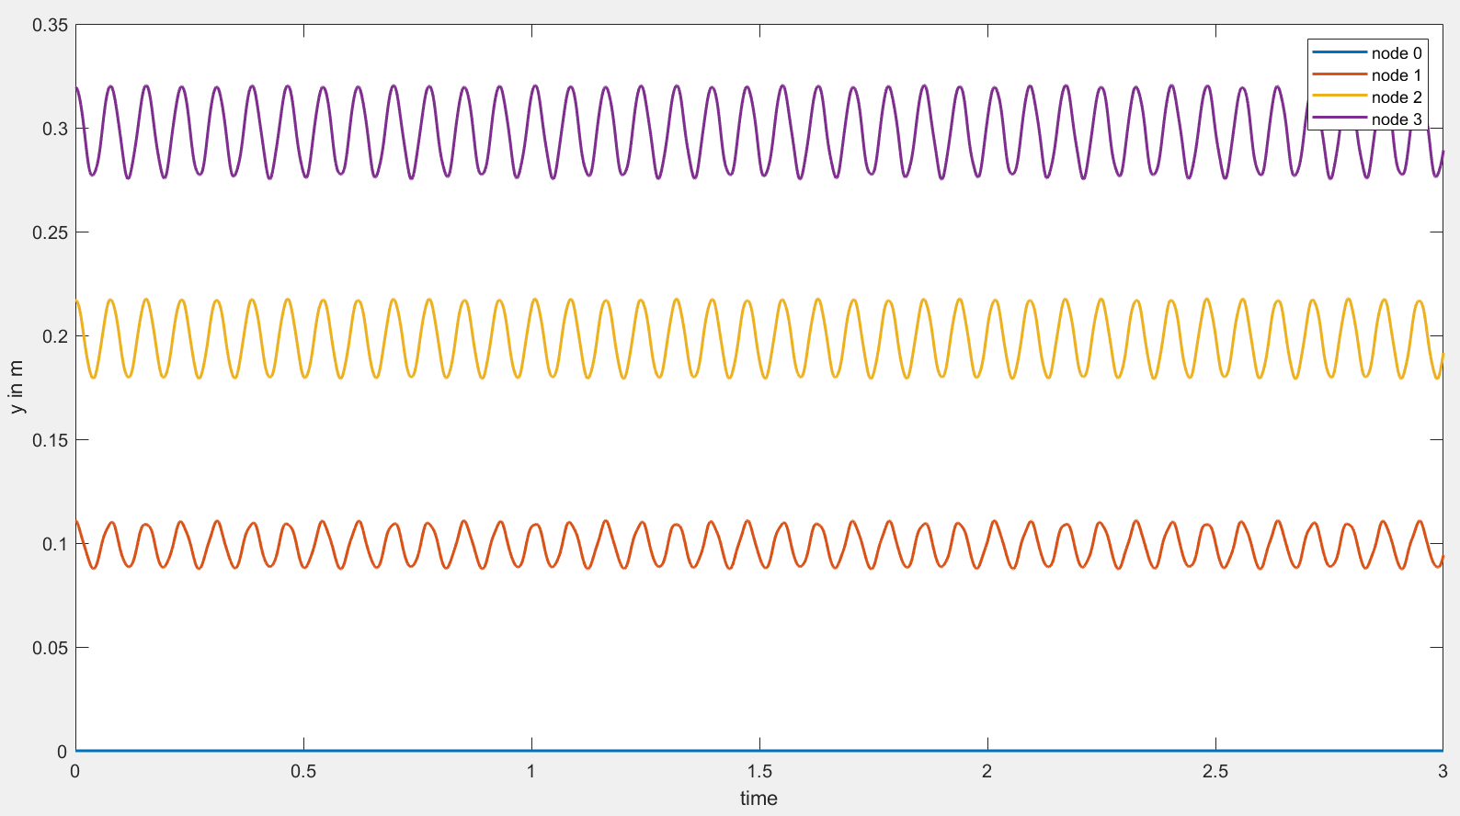
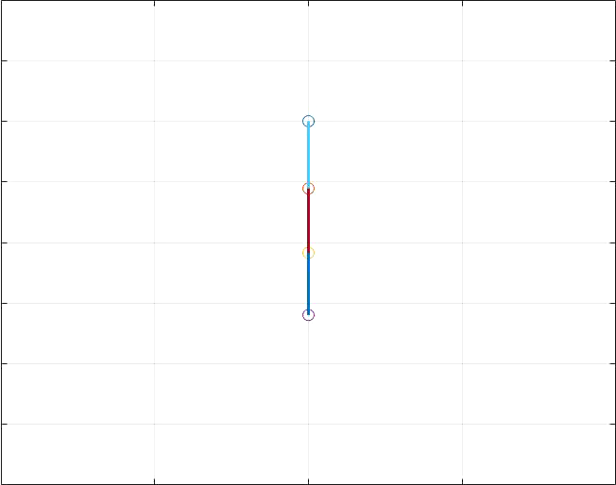
Results

Slide 18
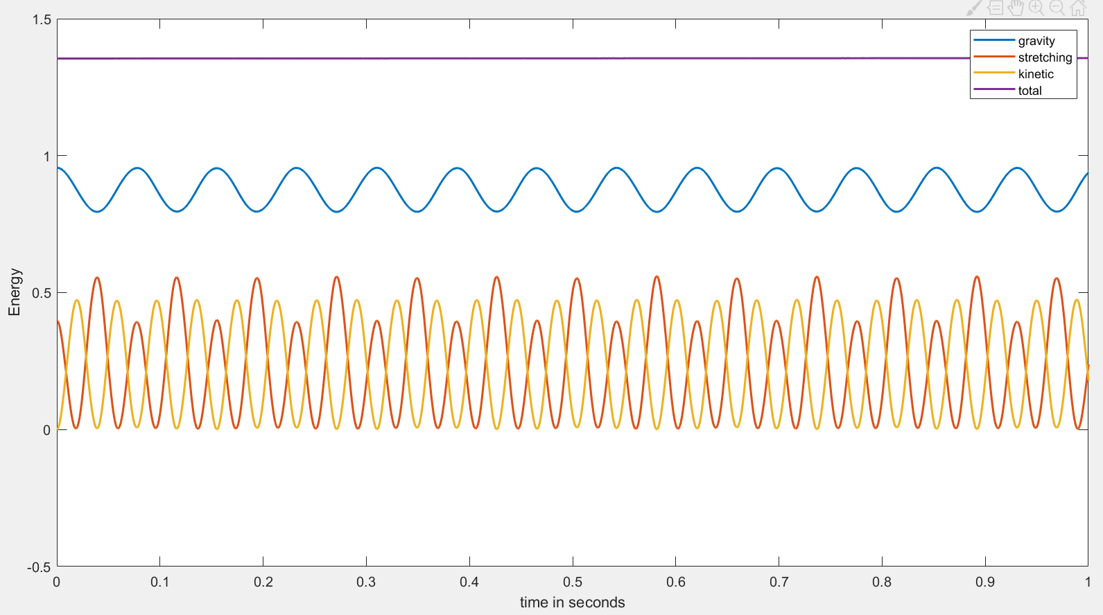
Results (Contd.)

Slide 19
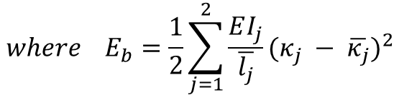
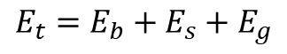
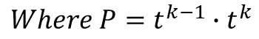
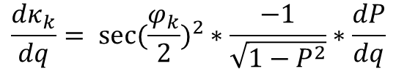
Case 2: bending and Stretching
The links are assumed to be rigid.
Nodes are non-linear torsional springs.
Total energy of the system is-
In order to compute the differential of Eb we need to compute-
$$E_{t}=E_{b}+E_{s}+E_{g}$$
$${where E}_{b}=\frac{1}{2}\sum_{j=1}^{2}{\frac{EI_{j}}{\overline{l_{j}}}{(κ_{j} − \overline{κ_{j}})}^{2}}$$
$$\frac{dκ_{k}}{dq}= {sec⁡(\frac{φ_{k}}{2})}^{2}∗\frac{−1}{\sqrt{1−P^{2}}}∗\frac{dP}{dq}$$
$$Where P=t^{k−1}∙t^{k}$$

Slide 20

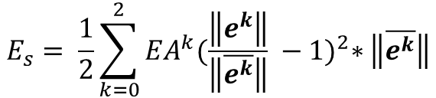
bending and Stretching (Contd.)
Potential energy due to stretching-
The only external force acting on the system is the constraint force. (As a result, velocity of node 0 is zero)
$$E_{s}= \frac{1}{2}\sum_{k=0}^{2}{EA^{k}{(\frac{\left\|e^{k}\right\|}{\left\|\overline{e^{k}}\right\|} −1)}^{2}∗\left\|\overline{e^{k}}\right\|}$$
Parameter | Value
EI | $$2 ×{10}^{−3} Nm^{2}$$
$$κ_{i}$$ | 0

Slide 21
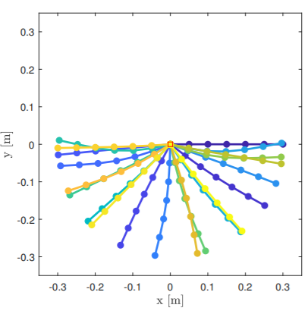
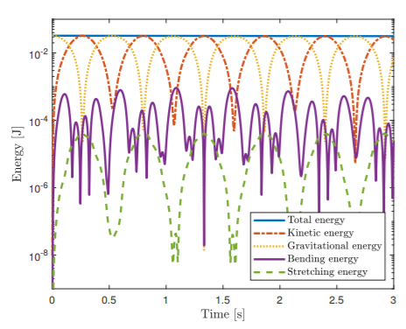
Results

Slide 22
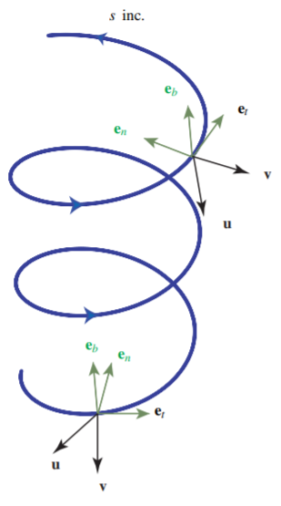
Future work
Extension of DER theory into 3 dimensions.
The center line is allowed to twist. (Configuration of the center line is captured by a set of triads.)

Slide 23
Thank you

